Slide 1

NATIONAL TECNOLOGY DAY
Saturday 11may 2024

Slide 2
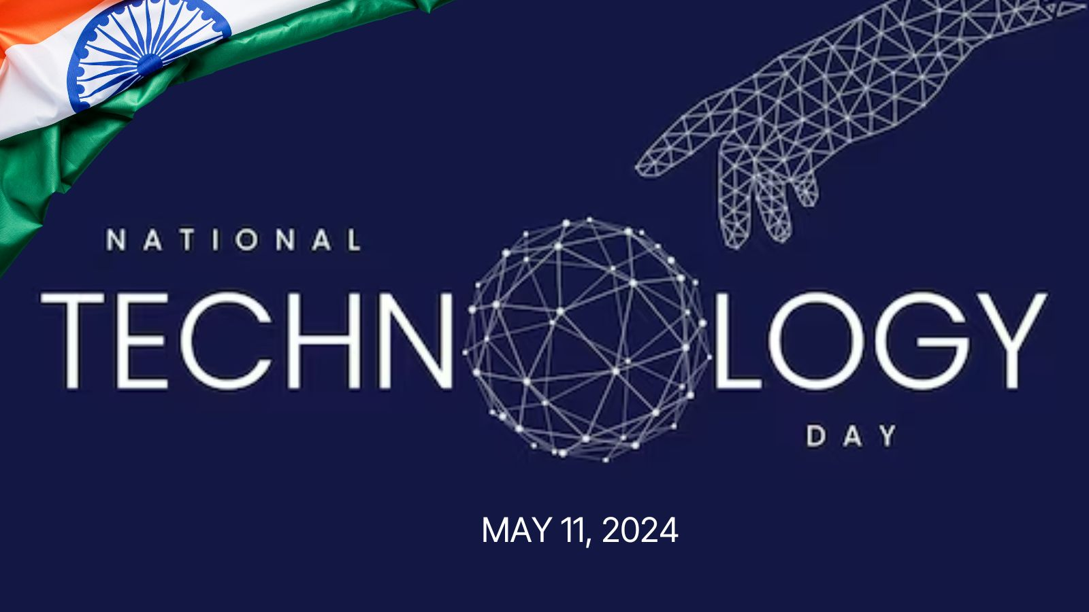
Why is National Technology Day celebrated?
National Technology Day 2024: National Technology Day is celebrated across India on May 11 to commemorate India's scientific advancement. On this day, India successfully tested nuclear bombs in Pokhran.

Slide 3
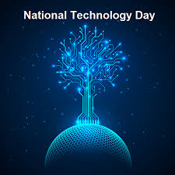
What is the theme of National Technology Day 2024?
National Technology Day 2024: The occasion is celebrated on May 11 to honor scientists and engineers. The theme for 2024 is 'School to Startups-Igniting Young Minds to Innovate', aiming to inspire innovation and startup culture.11 May 2024

Slide 4
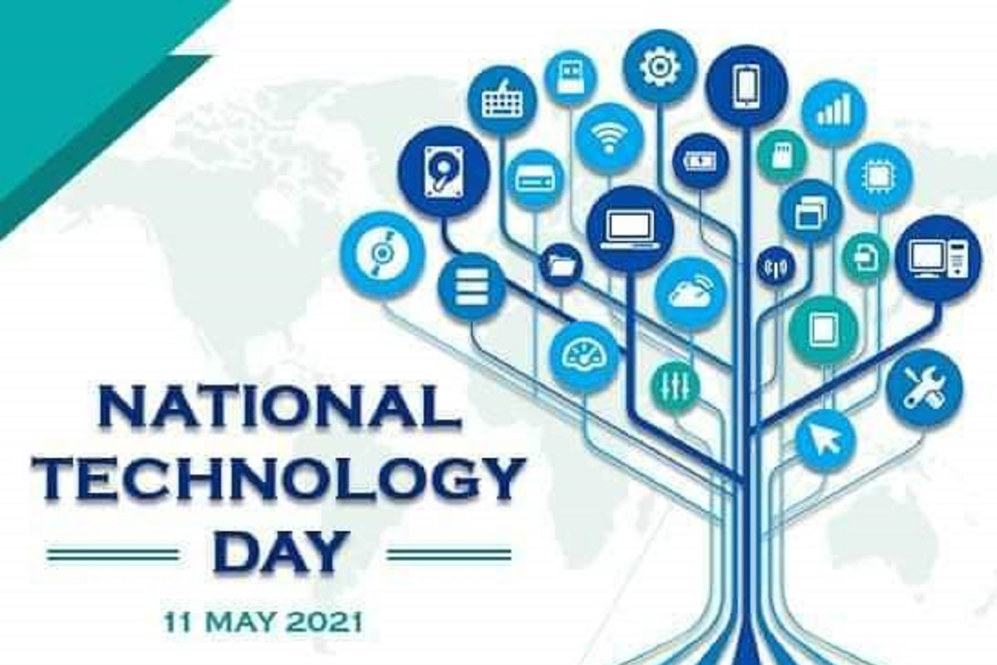
Who declared 11 May National Technology Day?
Considering the technological advancements, the then Prime Minister, Shri Atal Bihari Vajpayee, declared 11th May to be celebrated as National Technology Day every year. The major objective of the programmer is to generate awareness among the students, academia, general public etc.v

Slide 5
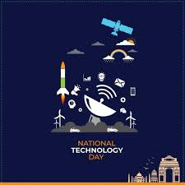
Who started National Technology Day?
Atal Bihari Vajpayee declared India a full Nuclear Country. Since 1999, 11th May is being observed as National Technology Day, with an aim to commemorate the achievements of scientists, researchers, engineers and all others involved in the field of science and technology.

Slide 6

Who is father of technology?
Thomas Edison
Thomas Edison created the world's first industrial research laboratory and is known as the father of technology

Slide 7
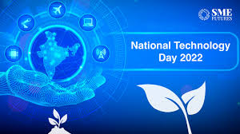
When was the first National Technology Day in India?
11 May 1999
The first National Technology Day was observed on 11 May 1999. The Pokhran nuclear tests were a significant milestone in India's efforts to achieve technological advancement and pave the way for future developments in the field.

